Slide 1

18ECC205J - Analog and Digital Communication UNIT 2
Contents of Week 1 Lecture
AM Transmitters
FM Transmitters
AM Receivers
-TRF
Source: Singh. R. P & Sapre. S. D, “Communication Systems: Analog & Digital,” 3rd edition, McGrawHill Education, Seventh Reprint, 2016.

Slide 2
AM Transmitter
A transmitter not only performs the modulation process, but also raises the power level of a modulated signal .
Two categories:
(i) Low level modulation
(ii) High level modulation

Slide 3
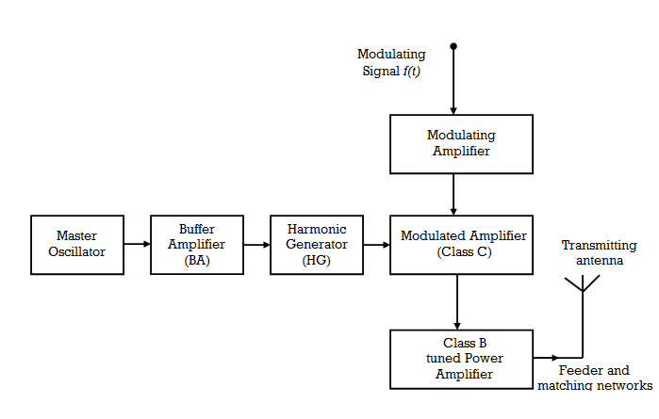
AM Transmitter using Low Level Modulation

Slide 4
Contd….
Modulation takes place at a low power level and signal is then amplified by a Class B power amplifier.
Limitation:
Lower efficiency of the Class B Amplifier.
Class C cannot be used because of narrow bandwidth, may lead to sideband cuttings and introduce distortion

Slide 5
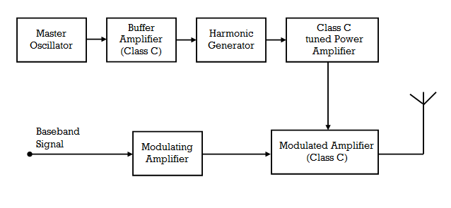
AM Transmitter using High Level Modulation

Slide 6
Contd….
Carrier is first amplified by a Class C amplifier and then modulation is done at higher level.
Only the carrier frequency is amplified ,so high gain and efficiency.
Complex and more expensive than low level transmitter.
Suitable for high power transmission.

Slide 7
Blocks of AM Transmitter
Master Oscillator (MO):
generates a stable sub –harmonic carrier frequency using a crystal oscillator.
Frequency is raised to the desired value by Harmonic generators.
If 1 MHz carrier frequency is required, a crystal oscillator is made to generate sub harmonic 250 KHz.
Increased four times by a harmonic generator to get 1 MHz carrier frequency.

Slide 8
Stability of MO Frequency
Reasons for change in frequency of a MO are
(i)Frequency Drift
Slow variation in frequency with respect to time.
The drift occurs due to variation in circuit parameters with temperature.

Slide 9
Frequency Scintillation
This means an abrupt change in the MO frequency due to the abrupt changes in the load oscillator. Any variation of load current is handled by the buffer amplifier and the master oscillator is not affected .
The following measures are adopted in order to keep the MO frequency stable.
Oscillator must be kept in a constant temperature chamber so that the circuit parameter does not change with a change in a temperature
Stabilized power supply should be used in the oscillator circuit.

Slide 10
Effective Q of the tuned circuits should be very high
The active devices used in the oscillator circuit should have a high value of the ratio (gm/c)
Master oscillator should generate a sub- harmonic of the carrier frequency.
Buffer amplifier must be used between the master oscillator and other stages.
Buffer Amplifier
This is a tuned amplifier providing a high input impedance at the master oscillator frequency.
Buffer amplifier isolates the MO from the succeeding stages so that the loading effect may not change the frequency of MO.

Slide 11
Harmonic Generator
It is an electronic circuit that generates of its input frequency.
Principle is same as that of the Non-Linear Modulator.
When a signal is applied to a non linear circuit ,it generates harmonics of input frequency.
The desired harmonic is selected by a properly tuned circuit.
The circuit uses a class C tuned amplifier. The current flows in the form of pulses recurring with the same frequency as the input signal.

Slide 12
Driver Amplifier or Intermediate power Amplifier
One or more stages of a class C tuned amplifier is used to increase the power level of a carrier signal.
This provides a large drive to the modulated class C amplifier.
The output of the harmonic generator provides a low power carrier signal.
This is amplified to raise the power to desired level to drive the final amplifier stage.

Slide 13
Modulation System
The collector modulation circuit is used for modulation in high power transmitters.
The modulating amplifier is a class A,or class B amplifier amplifying the baseband signal
Feeder and Antenna
The transmitter power is fed to a transmitting antenna for effective radiation through a properly designed transmission line called feeder.

Slide 14
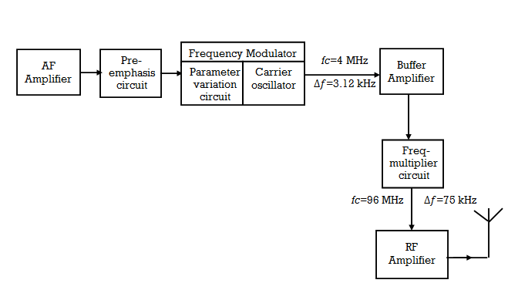
FM transmitter- Direct modulation

Slide 15
The modulator circuit uses parameter variation method.
A Pre emphasis circuit is used to reduce the effect of noise at higher audio frequencies for threshold improvement .
The Carrier oscillator generates sub harmonic of final carrier frequency to achieve frequency stability.
A stable oscillation frequency at a lower radio frequency (say 4 MHz) is generated by an oscillator, then raised to the final carrier (say 96 MHz) by frequency multipliers.
Frequency stability is obtained if the carrier oscillator operates at low frequency.
Multiplying circuit not only increases the carrier frequency but also the frequency deviation by the same factor.

Slide 16
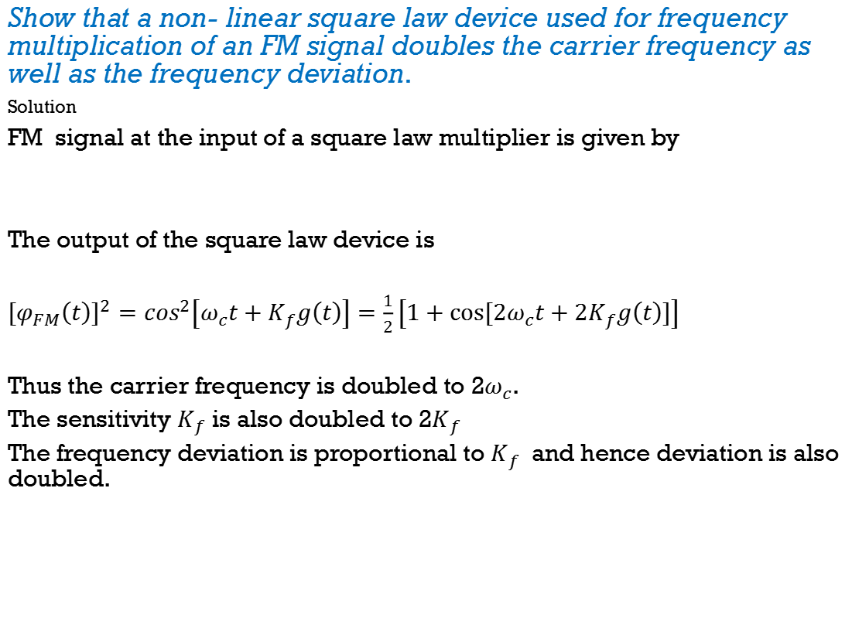
Show that a non- linear square law device used for frequency multiplication of an FM signal doubles the carrier frequency as well as the frequency deviation.
Solution
FM signal at the input of a square law multiplier is given by
The output of the square law device is
$${\left[φ_{FM}\left(t\right)\right]}^{2}=\cos^{2}\left[ω_{c}t+K_{f}g\left(t\right)\right]=\frac{1}{2}\left[1+cos⁡[{2ω}_{c}t+2K_{f}g\left(t\right)]\right]$$
Thus the carrier frequency is doubled to 2$ω_{c}$.
The sensitivity $K_{f}$is also doubled to 2$K_{f}$
The frequency deviation is proportional to $K_{f}$ and hence deviation is also doubled.
$$φ_{FM}\left(t\right)=cos⁡[ω_{c}t+K_{f}g\left(t\right)]$$

Slide 17
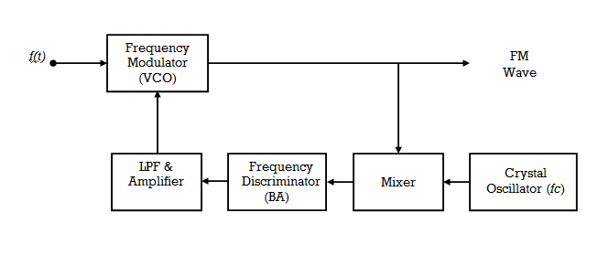
Frequency Stabilization Scheme

Slide 18
A stable crystal oscillator provides the reference frequency.
The output of the crystal oscillator and the frequency is fed into a mixer and the difference frequency term is got at the output of mixer.
The mixer output is then fed into a frequency Discriminator ,which provides an error voltage whose instantaneous value is proportional to the inst. Frequency of the input.
When FM wave has frequency equal to the assigned carrier frequency, the error signal is zero.
When there is a drift, the error signal is generated.
The amplified error signal is applied to a VCO ,to correct the transmitter frequency.

Slide 19
Armstrong (Indirect )method-FM Generation
Frequency stability of a higher order can be obtained because the crystal oscillator can be used as a carrier generator.
Basic principle is to generate a narrowband FM (NBFM) indirectly by using the phase modulation technique and then converting to Wideband FM (WBFM).
The distortion is low in NBFM and the modulation index is small.
The phase modulation is preferred because of its easy generation.
The multiplier circuit increases the carrier frequency as well as frequency deviation.

Slide 20
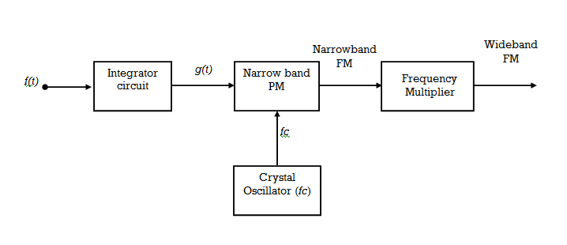
Armstrong (Indirect) method-FM Generation

Slide 21
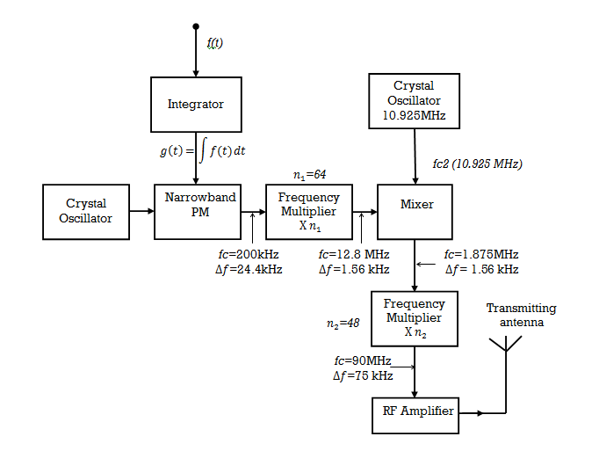
Armstrong FM Transmitter-Block Diagram
fc1 200kHz

Slide 22
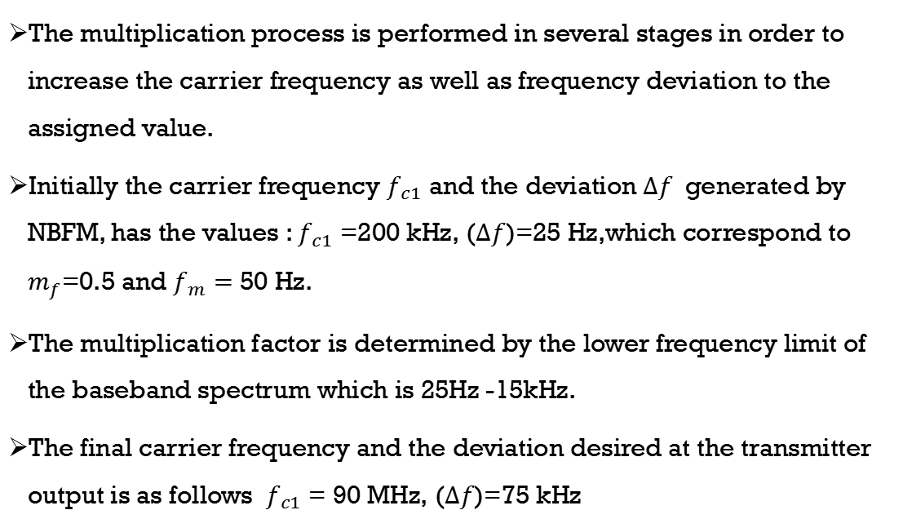
The multiplication process is performed in several stages in order to increase the carrier frequency as well as frequency deviation to the assigned value.
Initially the carrier frequency $f_{c1}$ and the deviation $∆f$ generated by NBFM, has the values : $f_{c1}$ =200 kHz, ($∆f$)=25 Hz,which correspond to $m_{f}$=0.5 and $f_{m}=$ 50 Hz.
The multiplication factor is determined by the lower frequency limit of the baseband spectrum which is 25Hz -15kHz.
The final carrier frequency and the deviation desired at the transmitter output is as follows $f_{c1}$ = 90 MHz, ($∆f$)=75 kHz

Slide 23
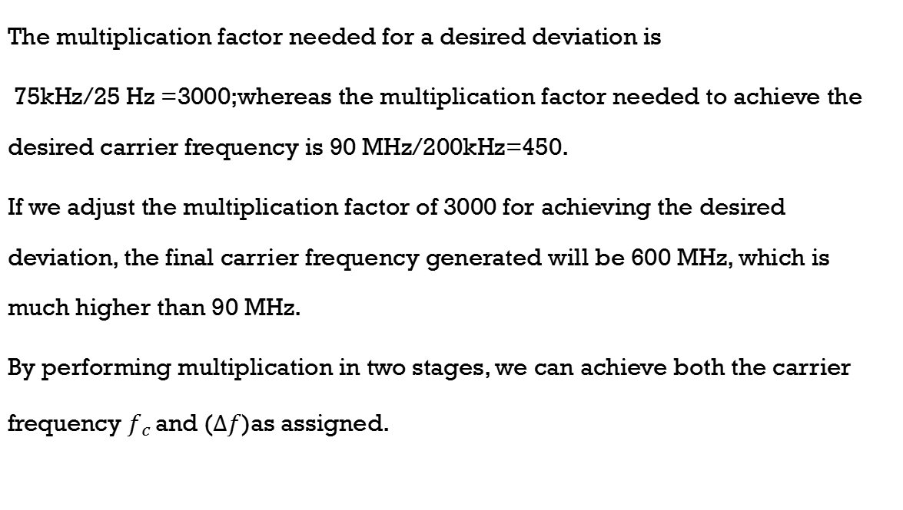
The multiplication factor needed for a desired deviation is
75kHz/25 Hz =3000;whereas the multiplication factor needed to achieve the desired carrier frequency is 90 MHz/200kHz=450.
If we adjust the multiplication factor of 3000 for achieving the desired deviation, the final carrier frequency generated will be 600 MHz, which is much higher than 90 MHz.
By performing multiplication in two stages, we can achieve both the carrier frequency $f_{c }$and $\text{(}∆f$)as assigned.

Slide 24
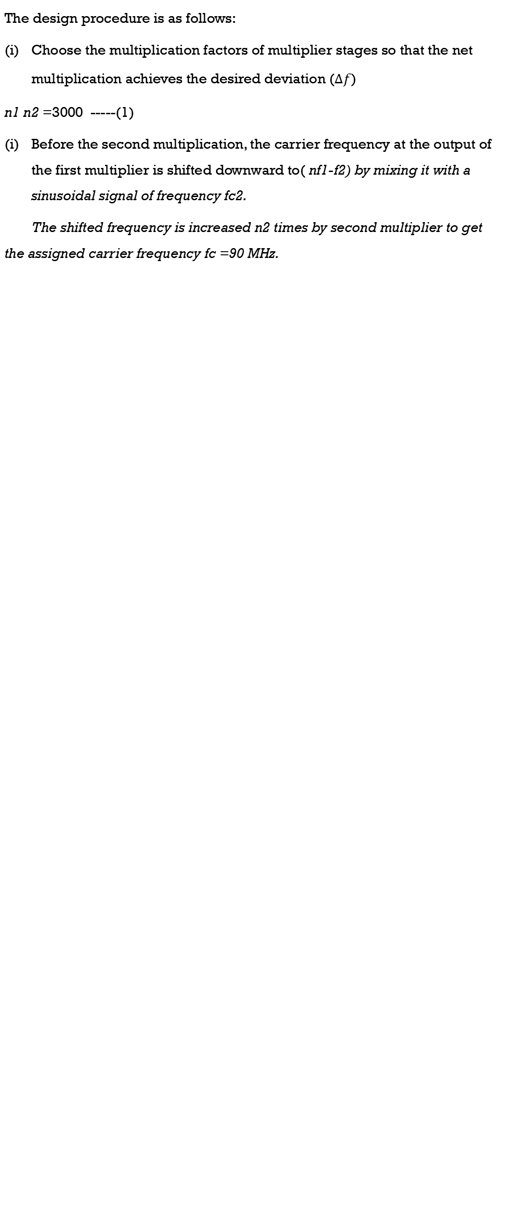
The design procedure is as follows:
Choose the multiplication factors of multiplier stages so that the net multiplication achieves the desired deviation $\text{(}∆f$)
n1 n2 =3000 -----(1)
Before the second multiplication, the carrier frequency at the output of the first multiplier is shifted downward to( nf1-f2) by mixing it with a sinusoidal signal of frequency fc2.
The shifted frequency is increased n2 times by second multiplier to get the assigned carrier frequency fc =90 MHz.

Slide 25
n2 (n1.f_{c1}-f_{c2}) =f_{c}
Substituting the values, we get
n2 (0.2 n1 -10.925)=90 -----(2)
Solving eqns 1 and 2 we get n1 =64.3 and n2=46.7
Rounding off n1 =64 =2⁶ and n2 =48=3x2⁴

Slide 26
AM Receivers
A radio receiver is an electronic circuit that picks up a desired modulated radio frequency signal and recovers the base band signal from it.
Types of Receivers:
Tuned Radio Receiver (TRF) receiver.
Super heterodyne Receiver
A Receiver performs the following functions.

Slide 27
( i) Interception:
The function is performed by a receiving antenna(small conductor).The radio waves coming from various transmitting stations arrive at this antenna
These radio waves contain electrical energy in the form of an electromagnetic wave.When this electro magnetic wave is intercepted by the receiving antenna , a voltage is induced in it.
A single antenna intercepts radio waves of all carriers frequencies.

Slide 28
(ii) Selection:
This is the process by which the receiver selects a particular desired carrier frequency and rejects others so that at any time a signal from only one is received.
This is done by a tank circuit. The resonant frequency of the circuit can be changed with the help of a variable capacitor or inductor

Slide 29
(iii) R.F.Amplification.
The selected carrier is amplified by a class of C tuned amplifier.
This is necessary to raise the voltage level so that linear diode detector following this stage may operate in linear region.
The increased carrier voltage also suppresses the effect of noise.
(iv) Detection
It is the process of recovering a baseband signal from a modulated carrier.

Slide 30
(v) Audio Amplification
The detected audio signal is further amplified so that it can drive the speaker.
This stage consist of R-C coupled amplifier followed by a class B push pull power amplifier
(vi) Reproduction
This is the process by which the electrical signal is converted into a desired physical message.
In a commercial broadcast receiver, the output of the audio amplifier is fed into a speaker that produces sound according to the input audio signal.

Slide 31
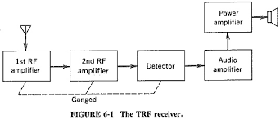
TRF Receiver
It performs all the above functions and work satisfactorily at medium wave frequencies.
At higher radio frequencies the performance of TRF becomes poor.The performance is improved by a technique known as a heterodyning
A receiver based on this technique is known as super heterodyne receiver

Slide 32
Features of Receiver
1. Selectivity
Selectivity is receiver’s ability between two adjacent carrier frequencies.
This feature tells us how perfectly the receiver is able to select the desired carrier frequency and reject the others.
Selectivity depends on the sharpness of the resonance curve of tuned circuits involved in the receiver.
Sharper the resonance curve , the better the selectivity.
Better selectivity means capability to reject undesired signals.

Slide 33
2. Sensitivity
The ability of a receiver to detect the weakest possible signal is known as sensitivity .A receiver with a good sensitivity will provide more output for similar input signal as against the poor sensitivity.
The sensitivity of a receiver is decided by the gain of its amplifying stages.
3.Fidelity
Fidelity of a receiver is its ability to reproduce the exact replica of the transmitted signals at the receiver output.
The amplifier must pass high bandwidth signals to amplify the frequencies of the outermost sidebands, while for better selectivity the signal should have narrow bandwidth.

